Slide 1
Lesson 2 LabVIEW FPGA Basics
Evaluating System Requirements
FPGA System Architectures
RIO Platforms
Software Installation
Windows Hardware Configuration
Real-Time Hardware Configuration
Creating a LabVIEW FPGA Project
Notes:
Lesson objectives:
Identify steps in LV FPGA development process. And note that some steps are iterative
Identify the two main FPGA architectures: PC/PXI with Windows and Real-Time
Know PC/PXI system includes card connected directly to host
Know that Real-Time system is distributed and FPGA resides on target
Use MAX to configure a cRIO system
Know that a LV FPGA system includes LV, LV FPGA, and NI-RIO software installed in that order on host machine
Use the LabVIEW project to create an FPGA project for both Windows and cRIO system
Understand project hierarchy and identify different "targets" & "devices" in Project
Understand that FPGA device differ by slices/gate count
Impacts amount of logic that can be implemented in HW

Slide 2
FPGA Development Flow
Evaluate
System
Requirements
Select
Architecture
Configure
Hardware
Create a
LabVIEW
Project
Lesson 2
Create
FPGA VI
Simulate on
PC to test
Compile to
FPGA
Create
FPGA Host
VI(s)
Create
Real-Time
Host VI(s)
Lesson 3
Lesson 8
Lessons 4-7, 9-10 build
on the development flow
Notes:
This slide shows the basic steps for developing your LabVIEW FPGA system.
Simulate System Requirements
The first step in any development project is to evaluate the requirements of the system.
Select Architecture
Once the system requirements are set, thought must be put into how the application should work as a whole. You’ll need to select your FPGA architecture and associated hardware.
Configure Hardware
Once you have all your system components, you’ll first configure your hardware in the Measurement and Automation Explorer. If you are developing your application without the hardware available, then you’ll skip this step.
Create a LabVIEW Project
You’ll then launch LabVIEW and create a LabVIEW Project for your system. Use the LabVIEW Project to manage and configure all resources for FPGA devices, such as CompactRIO Modules, I/O, clocks, FIFOs and VIs. When using a LabVIEW Real-Time platform with a LabVIEW FPGA device, you must add the following resources in order:
Real-Time target (if you are using CompactRIO or PXI controller, otherwise My Computer is the target)
FPGA Target (that is, the CompactRIO backplane or R Series device)
CompactRIO Expansion Chassis (R Series only)
CompactRIO Modules (if applicable)
Create FPGA VI
You’ll then start your LabVIEW FPGA VI.
Simulate on PC to test
Because of the technology used in FPGA, compiling FPGA code can take anywhere from minutes to hours and LabVIEW FPGA is no exception. Therefore, before you compile, you’ll want to simulate execution on the PC to catch any problems prior to the compile step.
Compile to FPGA
A Compile Server turns FPGA VI into a bitstream file that is targeted to your FPGA
Create FPGA Host VI
Unless you are creating a standalone application, you’ll want your FPGA VI to interact with your host system. You can use either LabVIEW for Windows or LabVIEW Real-Time as a host.
Create Real-Time Host VI
If you selected a Real-Time architecture, you might also need a Real-Time Host VI. In this case your FPGA Host VI will be on your Real-Time controller and your will create a separate user interface or other host VI for your Windows system.
In Lesson 2, you’ll learn about selecting the different FPGA architectures and related system components. We’ll then configure the hardware for your cRIO system. To understand the differences between the different architectures, we’ll create two different LabVIEW projects – one for a Windows FPGA system and one for a Real-Time cRIO system.
In chapters not noted in the slide, other topics are addressed that built upon these basic steps in the development process. This is simply to show the development process in terms of initial coverage in lessons.

Slide 3
A. Evaluating System Requirements
FPGA?
PCI
PXI
FPGA for Real-Time
CompactRIO
Need FPGA?
Select RIO Architecture
Select a Platform
PXI
Other Considerations
FPGA for Windows
PCI
FPGA “Size”
I/O
Connectors
…
Systems demonstrated in
Course exercises
Notes:
When adopting FPGA the first consideration is the system architecture. Will the system be a Window-based system or a Real-Time system? After that you need to select the packaging or form-factor for your system. Will you use a desktop machine or a PXI system? Do you need a plug-in board? Do you need CompactRIO? Once you’ve decided on the form factor, then there other considerations – What type of I/O channels do you need and how many do you need?
NI’s sales force and ni.com/fpga will help you with these decisions.
Throughout this course the lessons will illustrate concepts for both architectures. Specifically, course exercises will be based around two systems: a PCI R Series board and a CompactRIO system. Most concepts apply to both architectures. However, in areas where the systems differ – such as configuration -- the course material will cover both architectures.
Let’s look at these two reconfigurable I/O architectures in more depth….

Slide 4
B. FPGA System Architectures
LabVIEW FPGA Architecture on Windows
LabVIEW FPGA Architecture with LabVIEW Real-Time

Slide 5
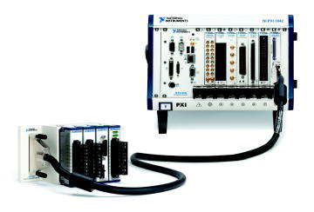
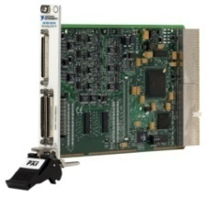
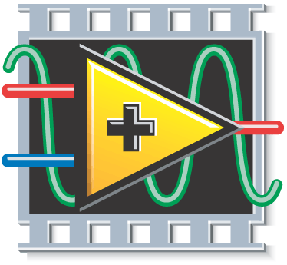

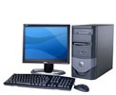
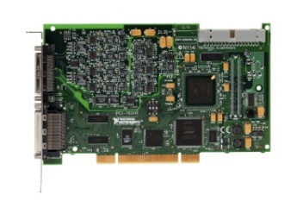
FPGA – Windows
Windows System
Reconfigurable FPGA
LabVIEW
For Windows VI
FPGA
Interface
LabVIEW
FPGA VI
Enterprise
LabVIEW
for Windows
LabVIEW FPGA
Notes:
FPGA – Windows is the first type of FPGA system architecture. In this system, the host device is a PXI or desktop PC running the Windows operating system. The RIO device is either a PXI or PCI plug-in device. This system architecture uses the following VIs:
LabVIEW FPGA VI—Executes on the FPGA of the PXI or PCI RIO device.
Host VI—Executes on the host PC, controls the FPGA, and provides a user interface to the system.

Slide 6
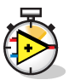
FPGA – Real-Time
Windows System
LabVIEW Real-Time System
Reconfigurable
FPGA
Network
Communication
Inter-Thread
Communication
FPGA
Interface
Windows
Host VI
Normal Priority
VI
Time-Critical
Interface VI
LabVIEW
FPGA VI
User
Interface
Data Storage
LabVIEW
for Windows
LabVIEW FPGA
LabVIEW Real-Time
Notes:
FPGA – Real-time is the other major FPGA system architecture. In this system the FPGA is running within a LabVIEW real-time system. The real-time system is typically on either a PXI or CompactRIO controller. This system architecture uses the following VIs.
LabVIEW FPGA VI—Executes on the FPGA of the PXI or PCIO RIO device.
LabVIEW Real-Time VI—Executes on a dedicated processor running a real-time operating system and adds deterministic, floating-point processing and control algorithms to the system.
Host VI—Executes on the host PC and contains the user interface for the real-time system
Note that users develop all the VIs (FPGA, Real Time, and Host) on the Windows System. The Real-Time and FPGA VIs are then deployed to the Real-Time system.
Refer to the LabVIEW Real-Time Application Development course or visit ni.com/realtime for more information about developing well-architected LabVIEW Real-Time applications.

Slide 7
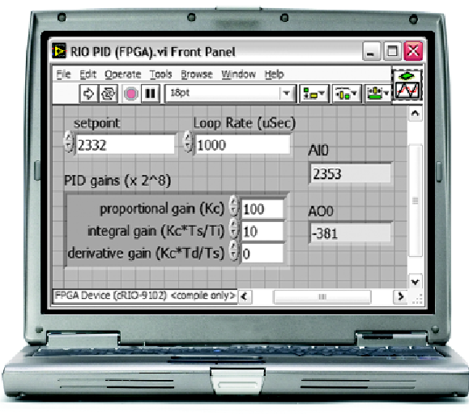
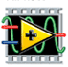
LabVIEW Programming & CompactRIO
User Interface
LabVIEW
Real-Time Processor
LabVIEW Real-Time
Reconfigurable
FPGA
LabVIEW FPGA

Slide 8
C. Common Reconfigurable I/O (RIO) Platforms
PXI Express
PXI
PCI Express
PCI
CompactRIO
Notes:
After you’ve selected your architecture, you’ll need to pick your FPGA platform or form factors. The most common form factors are PXI, PCI, and CompactRIO.

Slide 9
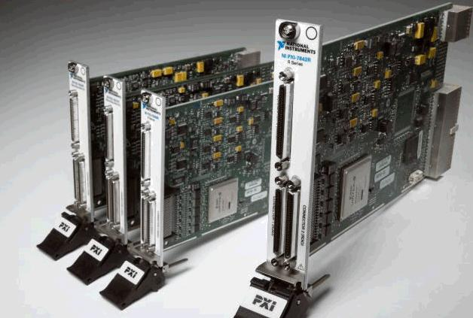
R Series Multifunction RIO
PXI, PXI Express, or PCI form factor
Define custom data acquisition
Integrate FPGA with Analog and Digital I/O
High channel count
Notes:
The R Series Multifunction RIO devices come in either PCI or PXI form factor. The PCI cards are using for Desktop systems running Windows. PXI systems can be either Window-based systems or Real-Time Systems.
You can customize your own data acquisition using the NI R Series Multifunction RIO devices which integrate FPGA technology with analog and digital I/O. These devices are used for high speed applications that require precise timing and control.
The Digital R Series devices have 160 digital lines that can be configured for inputs, outputs, counters, or custom logic at rates up to 40 MHz.

Slide 10
Building a CompactRIO System
Select the Reconfigurable Chassis
Number of slots
FPGA size
Integrated or not
Select the Real-Time Controller
Processor speed
Flash memory size
Select the I/O and Connectivity
Analog Input/Output, Digital Input/Output, …
(Low / high speed, simultaneous / multiplexed)
Standard connector depends on the module
Options: Strain Relief Connector Block, Custom Cable, etc.
Notes:
CompactRIO is an small, rugged embedded control and data acquisition system that is very modular. There are many component considerations when designing your CompactRIO system.
The Controller module is an embedded real-time processor that is the brains of the system. It communicates with the I/O modules, performs embedded control and logging, and communicates via Ethernet and serial. For the controller, you’ll need to consider processor speed and flash memory size. The Controller module communicates with the I/O modules via the FPGA on the Chassis. Some controllers are integrated with the chassis while others are separate components. There are 4 and 8 slot chassis available. Typically the more CompactRIO modules and the more I/O you need, you’ll need a larger chassis and a larger FPGA.
There is a broad selection of I/O modules – Analog I/O with various signal conditioning – Thermocouple, RTD, Bridge Sensors. Digital I/O, Counters, Pulse Generation, etc.. Refer to ni.com/compactrio for more information on the CompactRIO platform.

Slide 11
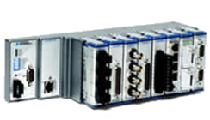
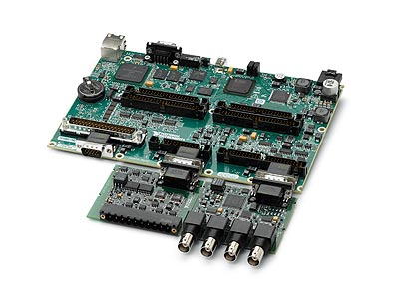
Other CompactRIO Form Factors
NI CompactRIO
Integrated Controller
NI Single-Board RIO
Notes:
The CompactRIO Integrated controller is a lower cost solution than the systems with separate controllers and chassis. The integrated solution is ideal for volume usage. The benefit of the separate controllers and chassis is that you can upgrade your processor speed, FPGA size, and/or number of slots independently of each other. The non-integrated solution might be a better choice while developing your application – but when you want to replicate it – the integrated system might be a better choice.
NI Single-Board RIO is a low-cost embedded deployment solutions based on NI CompactRIO platform. It is intended for high volume/OEM usage. You program it the same as other CompactRIO devices but you can customize the enclosure. The photograph in slide shows a single-board RIO device with a total of 4 modules – and space for one more. Note that CompactRIO devices have already been certified for shock and vibration. Users opting for SB-RIO will need to conduct these tests and obtain ‘packaging’ certification for their own enclosures.

Slide 12
FPGA “Size”
Historically, FPGA size was measured by “gate count”
The “larger” FPGA had more resources than a “smaller” FPGA
Now, FPGA logic blocks and resources differ so logic capacity and performance comparisons are tricky
FPGAs include a variety of resources and logic blocks
RAM, Multipliers, Flip-Flops, Look-up-Tables (LUTs)
Logic blocks differ in capabilities
4-input LUT vs. 6-input LUT
Difficult to map LabVIEW VIs into FPGA resources
Xilinx compiler optimizes code based on FPGA architecture
Verify that code fits by compiling for offline hardware targets
Resource estimation takes significantly less time than compilation
Notes:
Once you know your FPGA architecture and form factor, you need to consider other things like connectors, processor speed, etc. One consideration for both PC-based systems and CompactRIO based system is the FPGA Size.
Initial LabVIEW FPGA targets are based on the Xilinx Virtex II family of FPGAs. A “larger” FPGA always had more resources than a “smaller” FPGA, and performance was comparable. But, “gate count” is no longer an effective measurement of FPGA capacity or performance.
Xilinx introduced a Spartan series and other Virtex FPGAs that were optimized for different application needs. The Spartan series was a low-cost and low-power solution which still used “gate count” as a metric, but there were fewer specialty resources like block RAM and multipliers.
The Virtex 5 and 6 series increase the number of specialty resources and changed the logic components. Instead of 4-input LUTs used in the Virtex II family, the Virtex 5 and 6 series use 6-input LUTs.
Similar gate counts may have significantly different capabilities. Effective size depends upon application resource needs. Subtle internal differences impact resource utilization.

Slide 13
FPGA Resource Table
 | Virtex II 1000 | Spartan 3 1000 | Virtex 5 LX30 | Virtex II 3000 | Virtex 5 LX50 | Spartan 3 2000 | Virtex 5 LX85 | Virtex 5 LX110
Equivalent Logic Cells | 11,520 | 17,280 | 30,720 | 32,256 | 46,080 | 46,080 | 82,944 | 110,592
LUTs/FFs | 10,240 | 15,360 | 19,200 | 28,672 | 28,800 | 40,960 | 51,840 | 69,120
Multipliers | 40 | 24 | 32 | 96 | 48 | 40 | 48 | 64
Block RAM (Kb) | 720 | 432 | 1,152 | 1,728 | 1,728 | 720 | 3,456 | 4,608
Sample NI Products | cRIO-9101 | cRIO-9072 | cRIO-9111 PXI-7851R | cRIO-9104 PXI-7833R | cRIO-9113 PXI-7852R | cRIO-9074 | cRIO-9116 PXI-7853R | PXI-7854R
Refer to http://zone.ni.com/devzone/cda/tut/p/id/7440 for more information.
Notes:
In general:
If you are starting a new design, use a device with a Virtex 5 chip. These chips have higher performance and more specialty resources. New designs are often not the most efficient so you’ll need more resources. Virtex 5 are good for extensive math operations and SCTL. You should only buy any of the Virtex II unless you have a specific reason like a showstopper I/O mix, or replacements for an existing deployment.
Once you’ve optimized and know more about the resources your application needs – then consider deploying to a lower cost solution – such as a device using the Spartan 3 chip.

Slide 14
Exercise 2-1: Set up a CompactRIO System
Connect and power up a CompactRIO system.
Notes:
Prep discussion:
In this exercise, students get familiar with the course hardware by assembling and connecting a CompactRIO system to the Sound and Vibration Simulator demo box. They also connect power cables and power on Sound and Vibration Simulator demo box.
If using the 9074 controller, note that the FPGA is part of the integrated controller.
There are three cRIO I/O modules in the chassis – two input and one output module.
Note that cRIO supports hot-swappable modules, so you can change when controller is powered up. This is not true for PCI or PXI devices!
In preparation for future exercises, you’ll be making the following connections:
NI-9211 thermocouple module needs to be connected to two J-type thermocouples.
The NI 9263 analog output module needs to controls the fan speed. Therefore, one of the outputs needs to be connected to the fan speed control.
The NI 9233 input module needs to be connected to a two-axis accelerometer and to a tachometer.
Be sure to make sure students wire up BNC cables correctly – Y acceleration input wired to CH0 and X acceleration wired to CH1! Students sometimes accidently swap these.

Slide 15
Exercise 2-1: Set up a CompactRIO System
If you need to swap modules, do you first need to power off the CompactRIO system?
Both the FPGA and USER1 LEDs are user-configurable. What do you think are their differences?
Notes:
One of the advantages of CompactRIO is the modules are hot-swappable. Therefore, users can switch modules in the field without first turning off their systems. Not true for PCI or PXI devices!
Both the FPGA and USER1 LEDs are user configurable and can help provide status feedback. The FPGA VI is user configurable from the LabVIEW FPGA. The USER1 LED is often referred to as an RT user LED as it is configurable from LabVIEW Real-Time. Although there are digital modules available, this course setup doesn’t include one. Therefore, we will control the FPGA LED in a later lesson.
If using the 9074 controller, the 2nd Ethernet port can be used for an expansion module to access additional I/O or it can be used to connect to another Ethernet-based device. The 2nd Ethernet port is not intended to be used for redundancy.
The tachometer measures rotation speed of a shaft or disk. In this course it will be used to measure fan speed. The two-axis accelerometer will be used to measure fan vibration.
Note that students might have modules that won’t be used in this course. Extra module(s) should be in slot 4 or above.

Slide 16
D. Software Installation
Before installing any device:
Install LabVIEW
If using a Real-Time controller, install LabVIEW Real-Time
Install LabVIEW FPGA
Install NI-RIO or other target-specific software
Notes:
A. Hardware Configuration
Measurement & Automation Explorer (MAX) is the gateway for managing connections to all NI devices.
Before connecting any device, you must complete the following steps to install the software and drivers for the device.
Install LabVIEW
Install LabVIEW Real-Time
Install the compatible version of LabVIEW FPGA.
Install the latest compatible version of driver software for your device.
Refer to ni.com/updates to find the latest updated driver software .
After you install the appropriate software you can connect the device to the computer in use. The installation instructions may vary depending on which device is in use. Devices may be connected directly to the PC or connected remotely through a network connection.

Slide 17
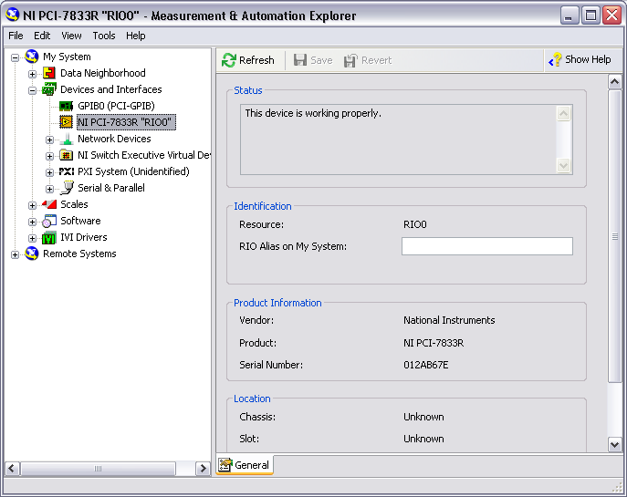
E. Windows Configuration
Notes:
If you are using a PCI or PXI device that is running in your Windows PC, follow the installation instructions included with the device to recognize the FPGA device. After following the installation instructions, your device will appear in MAX under My System»Devices and Interfaces, and you can directly target your FPGA device. This form of setup typically is the easiest because you do not have to worry about network connection problems.

Slide 18
F. Real-Time Configuration
Detect the Remote Target
View Devices and Interfaces
Add/Remove Software
Configure Target Network Settings
Select Host-Target Network Setup

Slide 19
Real-Time Configuration
Detect the Remote Target
View Devices and Interfaces
Add/Remove Software
Configure Target Network Settings
Select Host-Target Network Setup

Slide 20
Host-Target Network Setup
Options:
Host and Target connected to Local Area Network
Typically uses DHCP
Host and Target connected directly using a crossover cable
Host and Target need an IP Address
To configure remote system
Host and Target need to be on the same subnet
Might need to temporarily disable your Firewall

Slide 21
Configure Network Settings
IP Address – the unique address of a device
a set of four one- to three-digit numbers in the range 0–255
dotted decimal notation.
example IP address: 224.102.13.24
Subnet Mask – a code that helps the network device determine whether another device is on the same network.
255.255.255.0 is the most common subnet mask
Gateway (Optional) – address of a gateway server (a connection between two networks)
DNS Address (Optional) – address of a device that stores DNS host names and translates them into IP addresses
Notes:
The Gateway and DNS address settings are optional because they are automatically generated.

Slide 22
IP Addressing Options
Option | Description
DHCP assigned | IP address automatically assigned by DHCP server. DHCP is a common network protocol for administering IP addresses.
Link-local | IP address allocated using automatic private IP addressing when DHCP server not available. AutoIP attempts to assign an address using DHCP first then link local if DHCP fails. Address range: 169.254.x.x
Static IP | Manually assigned IP address
Notes:
Other names for link local: AutoIP, APIPA (Automatic Private Internet Protocol Addressing), Zero configuration network or zeroconf.

Slide 23
IP Addressing Options
Option | Windows Host | Real-Time Controller
DHCP | Default | Default
Link-local | Default if fail to connect to DHCP | Assigned automatically using AutoIP* or configurable in MAX.
Static IP | Configurable in Windows | Configurable in MAX
* AutoIP available with some controllers and/or versions of Real-Time.

Slide 24
Ethernet Cabling Options
Option | Use when…
Standard | Host and target are connected with hub, router, or network switch
Crossover | Directly connecting host and target

Slide 25
FPGA for Real-Time Configuration
Detect the Remote Target
View Devices and Interfaces
Add/Remove Software
Configure Target Network Settings
Select Host-Target Network Setup

Slide 26
Detect Remote Target - CompactRIO
Connect CompactRIO to PC through a network
Power up CompactRIO
Not configured CompactRIO – Status light blinks slowly
Open MAX (Start»Programs»National Instruments)
Remote Systems in MAX– Devices connected over the Ethernet

Slide 27
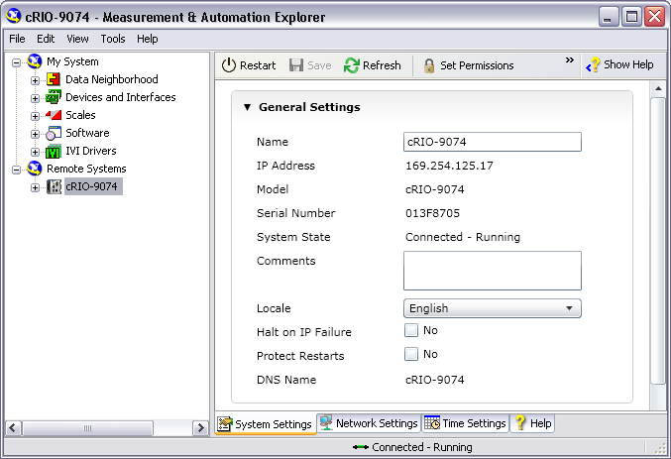
Detect the Remote Target

Slide 28
FPGA for Real-Time Configuration
Detect the Remote Target
View Devices and Interfaces
Add/Remove Software
Configure Target Network Settings
Select Host-Target Network Setup

Slide 29
Configure Network Settings – IP Address
Recommended approach:
Attempt to obtain IP address automatically
Will work if connected to DHCP or controller supports AutoIP
If fail, then specify IP address using suggested value

Slide 30
Configure Network Settings – DHCP & AutoIP
Automatic IP Address from DHCP Server or APIPA
Select Obtain an IP address automatically
Click Apply
Notes:
Address allocated on each reboot. Not guaranteed to be the same address.
Might need to enable IP Reset switch

Slide 31
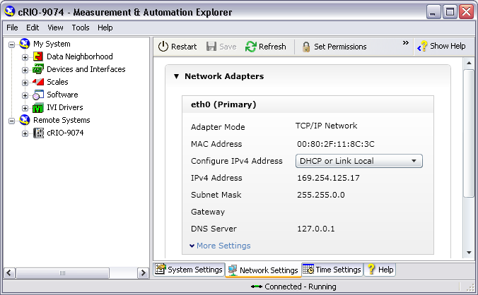
Configure Network Settings – DHCP & AutoIP
4
2
3
1
Notes:
If a Gateway and DNS are not available, leave them blank.

Slide 32
Configure Network Settings – Link Local or Static IP
Manually assign a static IP
Select Use the following IP address
Click on Suggest Values… to view suggested value
Click OK
Click Apply
Notes:
Address must be on same subnet as Windows host
Might need to enable IP Reset switch or set in Safe Mode

Slide 33
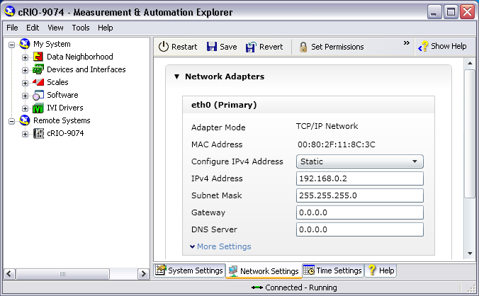
Configure Network Settings – Link Local or Static IP
2
3
1
Notes:
If a Gateway and DNS are not available, leave them blank.

Slide 34
FPGA for Real-Time Configuration
Detect the Remote Target
View Devices and Interfaces
Add/Remove Software
Configure Target Network Settings
Select Host-Target Network Setup

Slide 35
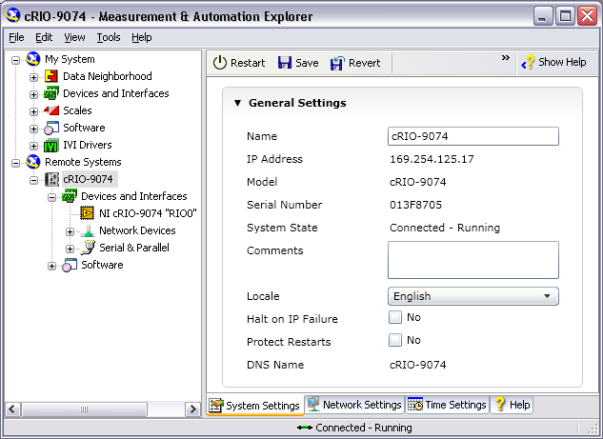
View Devices and Interfaces
Expand Devices and Interfaces to view the chassis
Notes:
Mention that “RIO0” is the name of the FPGA.

Slide 36
FPGA for Real-Time Configuration
Detect the Remote Target
View Devices and Interfaces
Add/Remove Software
Configure Target Network Settings
Select Host-Target Network Setup

Slide 37
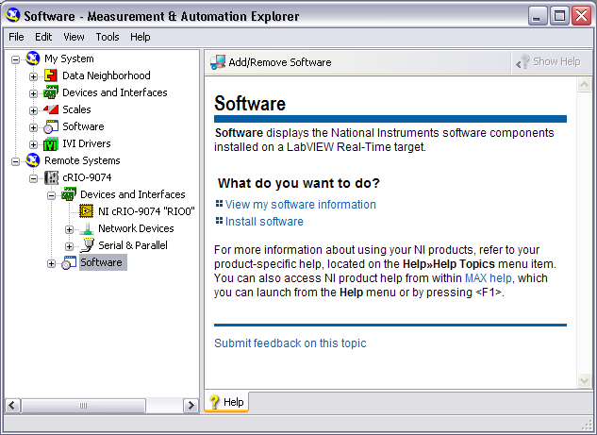
Add/Remove Software

Slide 38
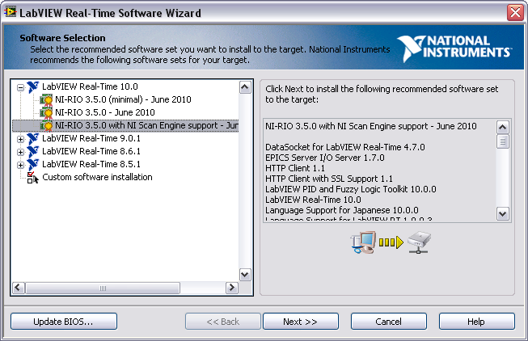
Add/Remove Software

Slide 39
Exercise 2-2: Configure a CompactRIO System
Use MAX to configure the CompactRIO.
Notes:
Prep discussion:
In this exercise, students connect their Windows host to the CompactRIO controller using a crossover Ethernet cable. The Windows host will default to AutoIP addressing. Students will configure the CompactRIO controller to use AutoIP addressing. They will use MAX to reformat their CompactRIO controller and install new software to the CompactRIO controller. For this course, students must install the NI-RIO driver to the controller.
Students are reformatting their controllers to experience the steps necessary to setup a new CompactRIO controller. New controllers only contain the ROM firmware needed for safe-mode boot setup. Students must install the Real-Time operating system and other software for the controller to be useful. Users will typically only reformat a controller if they don’t know the state of the software (for example, a coworker gave them a controller) and they want to start in a clean state.

Slide 40
Exercise 2-2: Configure a CompactRIO System
Why is it important to keep software synchronized between host PC and CompactRIO controller?
How would configuration change if you used DHCP?
Notes:
It is important to keep the software on the development machine synchronized with the software on the CompactRIO machine. If there are mismatches between the NI-RIO, LabVIEW Real-Time, and LabVIEW version software on the CompactRIO and those on the host machine, you will get errors when you attempt to deploy code to the FPGA and RT controller.
After initial software installation, users will typically not need to reformat their controller. They will only need to install new software on the on the controller (1) if they upgrade their software on the host machine as the NI-RIO driver needs to be synchronized between the controller and the host, or (2) they need to add or modify their software selection.

Slide 41
G. Creating a LabVIEW FPGA Project
Steps to create a LabVIEW FPGA Project:
Create a new project
Add a target
Add under “My Computer” if device is a local
Add under “Project” if device is a networked
Discover existing device or create a new device
For online devices, LabVIEW can also discover module and I/O nodes
For offline devices, add modules and I/O nodes
If device is a networked device, connect to the target
Notes:
G. Creating a LabVIEW FPGA Project
Select “Discover an existing” device is you’ve already configured your system in MAX and the device can be accessed from your development computer (i.e., an online device). Select “Create a new device” if the device cannot be accessed from your development computer (i.e., an offline device).
Students learn to add I/O nodes in Lesson 4.
Instructors: Indicate that users can also use the LabVIEW FPGA Project Wizard to create a new LabVIEW FPGA project. In this class, instructions will use the manual method.

Slide 42
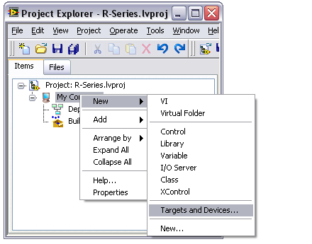
New FPGA Target – Windows
For local targets:
Right-click My Computer and select New»Target and Devices

Slide 43
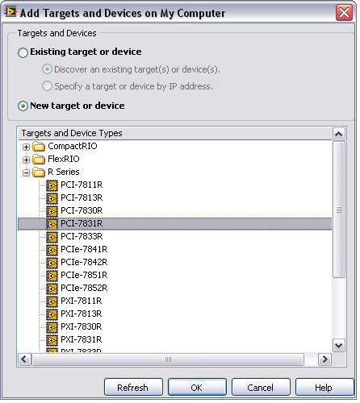
Add Targets and Devices – Windows
Existing target or device
Use when your device can be accessed from your development computer
New target or device
Use when you are not connected with a physical target or device is not present.

Slide 44
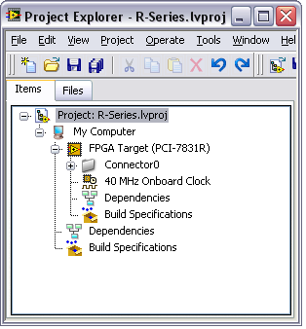
Windows Project
FPGA Target is under My Computer

Slide 45
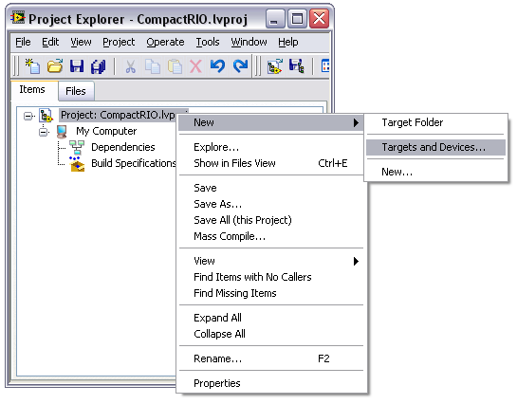
New Target – Real-Time Target
For remote targets:
Right-click on Project and select New»Target and Devices

Slide 46
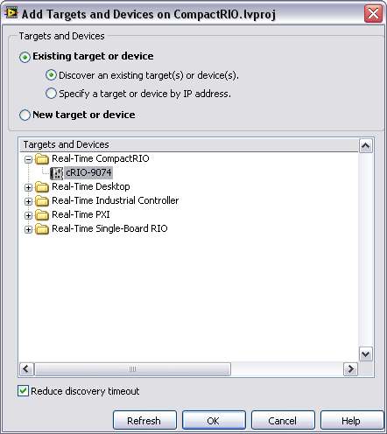
Add Targets and Devices – Real-Time Target
Existing target or device
Use when your device can be accessed from your development computer
New target or device
Use when you are not connected with a physical target or device is not present.

Slide 47
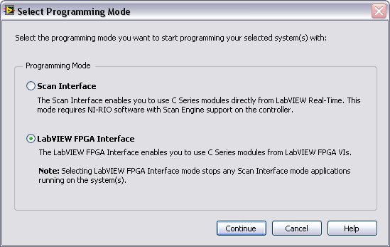
Select Programming Mode - CompactRIO

Slide 48
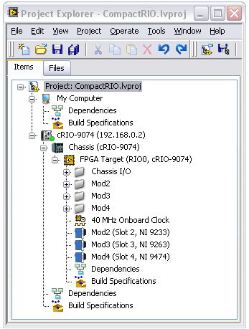
Project with CompactRIO Controller
My Computer and cRIO target are siblings
Bright green dot ➔ target connected
Dark green dot ➔ target not connected
Chassis is under cRIO target
FPGA target is under the Chassis
Notes:
Green light on Target indicates if the Target is connected or not. Bright Green → Connected. Dark Green → Not connected.

Slide 49
Exercise 2-3 & 2-4: Create Two LabVIEW FPGA Projects
Create LabVIEW FPGA Projects for the following two devices:
An offline PCI-7831R
An online CompactRIO 9074
Notes:
Prep discussion:
Students should pay particular attention to the steps in this exercise as in later exercises the instructions will not step users through the process but instead just instruct the students to create an R Series project for an offline device or a CompactRIO project for an online device.
Remind students that “offline” means a device that is not physically connected or accessible from the computer while “online” means a device that is accessible. In this course, student computers are connected to a cRIO controller. Student computers do not have an installed R Series board.

Slide 50
Exercise 2-3 & 2-4: Create Two LabVIEW FPGA Projects
Is it possible to create a simulated project for CompactRIO?
Manually add controller, chassis, and FPGA target
When would you not want LabVIEW to auto-discover your C Series modules?
Notes:
It is possible to create FPGA projects for CompactRIO devices. Since LabVIEW cannot auto-discover the chassis or modules, users will need to manually add the Chassis and modules. They do this through same right-click menu and selecting Add Target or Device. The Chassis needs to be added under the CompactRIO target. The FPGA appears under the Chassis. The user then adds the modules under the FPGA target.

Slide 51
Summary—Quiz
1. Which of the following operations are performed in MAX?
Install software on an R Series board
Install software on a CompactRIO target
Verify connection between host and a real-time target
Assign the IP address of your host computer

Slide 52
Summary—Quiz Answer
1. Which of the following operations are performed in MAX?
Install software on an R Series board
Install software on a CompactRIO target
Verify connection between the host and a real-time target
Assign the IP address of your host computer
Notes:
B and C.
MAX is used to install NI-RIO and other software onto a Real-Time controller such as CompactRIO. You do not install NI-RIO onto a R Series device.
You set the IP address of the controller in MAX. Your Windows IP address is configured in your Local Area Network properties.

Slide 53
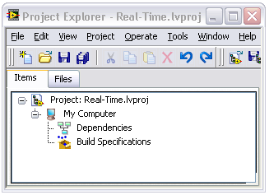
Summary—Quiz
2. Under which node do you add a CompactRIO target?
Real-Time.lvproj
My Computer
Dependencies
Build Specifications

Slide 54
Summary—Quiz Answer
2. Under which node do you add a CompactRIO target?
Real-Time.lvproj
My Computer
Dependencies
Build Specifications
Notes:
Since CompactRIO is a distributed system and doesn’t reside on the host computer, the CompactRIO controller target is added directly under the project. PCI R Series devices are added under My Computer.

Slide 55
Summary—Quiz
3. When would you select New target or device?
You evaluating an FPGA target to see if your application can run on the target
You are developing your application while traveling and you don’t have an FPGA target connected to your laptop
You are curious to see which NI-RIO targets and devices are supported under My Computer
All of the above

Slide 56
Summary—Quiz Answer
3. When would you select New target or device?
You evaluating an FPGA target to see if your application can run on the target
You are developing your application while traveling and you don’t have an FPGA target connected to your laptop
You are curious to see which NI-RIO targets and devices are supported under My Computer
All of the above
Notes:
There are many times where the desired hardware is not physically connected to your computer but you’d like to build an application, in which case you can still add the target or device manually.

